Slide 1
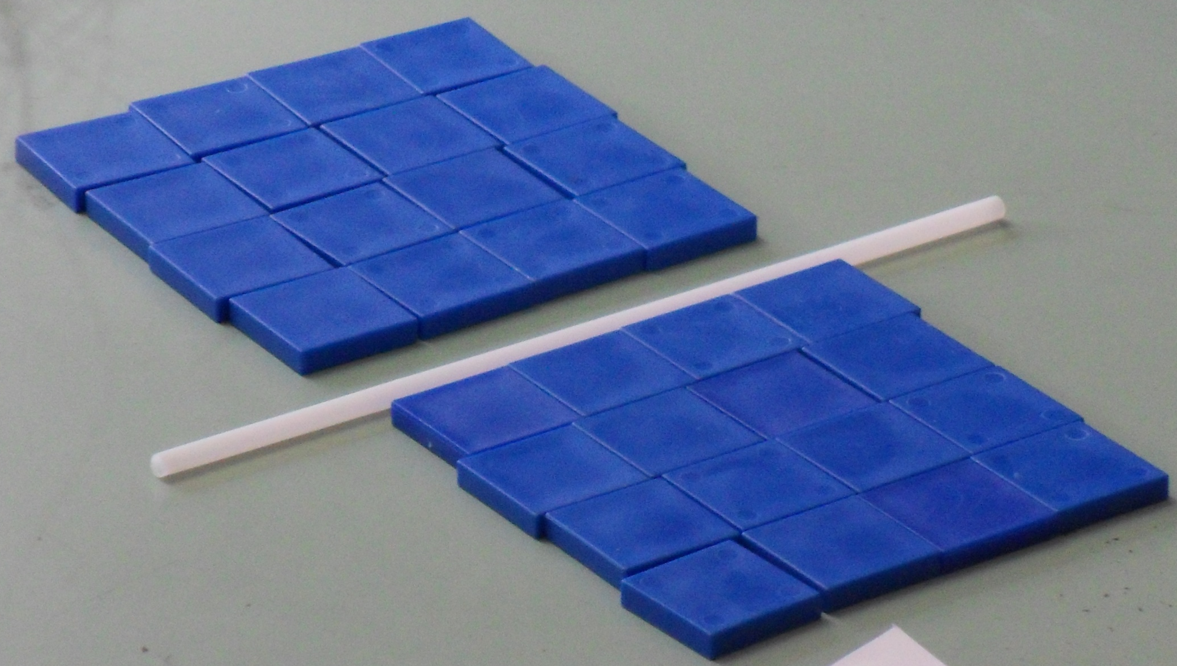
The distributive property of multiplication
8 × 4 = (4 × 4) + (4 × 4)
How might you split this array to work out 4 × 8?

Slide 2
Distributive property
One of the two factors in a product
can be split into two or more parts.
Example: 6 × 8 =

Slide 3
Distributive property
One of the two factors in a product
can be split into two or more parts.
Example: 6 × 8 =
6 × 5

Slide 4
Distributive property
One of the two factors in a product
can be split into two or more parts.
Example: 6 × 8 =
6 × 5
6 × 3

Slide 5
Distributive property
One of the two factors in a product
can be split into two or more parts.
Example: 6 × 8 =
6 × 5
6 × 3

Slide 6
Distributive property
One of the two factors in a product
can be split into two or more parts.
Example: 6 × 8 =
(6 × 5) + (6 × 3)
6 × 5
6 × 3

Slide 7
Distributive property
One of the two factors in a product
can be split into two or more parts.
Example: 6 × 8 =
(6 × 5) + (6 × 3)
6 × 5
6 × 3
Each part is multiplied separately and the partial products are then added.

Slide 8
Distributive property
One of the two factors in a product
can be split into two or more parts.
Example: 6 × 8 =
(6 × 5) + (6 × 3)
6 × 5 = 30
6 × 3
Each part is multiplied separately and the partial products are then added.

Slide 9
Distributive property
One of the two factors in a product
can be split into two or more parts.
Example: 6 × 8 =
(6 × 5) + (6 × 3)
6 × 5 = 30
6 × 3 = 18
Each part is multiplied separately and the partial products are then added.

Slide 10
Distributive property
One of the two factors in a product
can be split into two or more parts.
Example: 6 × 8 =
(6 × 5) + (6 × 3)
= 30 + 18
6 × 5 = 30
6 × 3 = 18
Each part is multiplied separately and the partial products are then added.

Slide 11
Distributive property
What is another way to split the array to make it easier to work out 6 x 8 ?
Example: 6 × 8 =

Slide 12
Distributive property
What is another way to split the array to make it easier to work out 6 x 8 ?
Example: 6 × 8 =
5 × 8

Slide 13
Distributive property
What is another way to split the array to make it easier to work out 6 x 8 ?
Example: 6 × 8 =
5 × 8
1 × 8

Slide 14
Distributive property
What is another way to split the array to make it easier to work out 6 x 8 ?
Example: 6 × 8 =
5 × 8
1 × 8

Slide 15
Distributive property
What is another way to split the array to make it easier to work out 6 x 8 ?
Example: 6 × 8 =
(5 × 8) + (1 × 8)
5 × 8
1 × 8

Slide 16
Distributive property
What is another way to split the array to make it easier to work out 6 x 8 ?
Example: 6 × 8 =
(5 × 8) + (1 × 8)
5 × 8 = 40
1 × 8

Slide 17
Distributive property
What is another way to split the array to make it easier to work out 6 x 8 ?
Example: 6 × 8 =
(5 × 8) + (1 × 8)
5 × 8 = 40
1 × 8 = 8

Slide 18
Distributive property
What is another way to split the array to make it easier to work out 6 x 8 ?
Example: 6 × 8 =
(5 × 8) + (1 × 8)
= 40 + 8
5 × 8 = 40
1 × 8 = 8

